Slide 1


iNTUition v10.0 Hackathon
Search
Team AeroBots
By Akshat Jain, Dheemant Rastogi, Priyansh Panchal
“Sky-Bot”

Slide 2
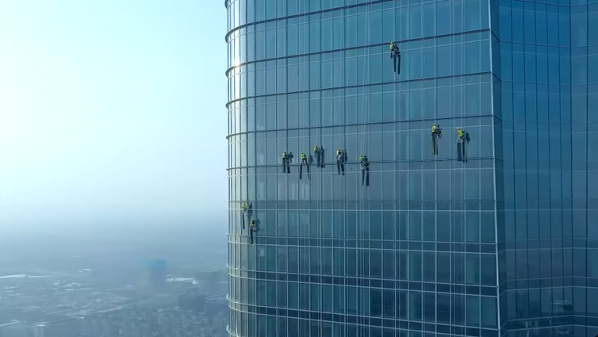
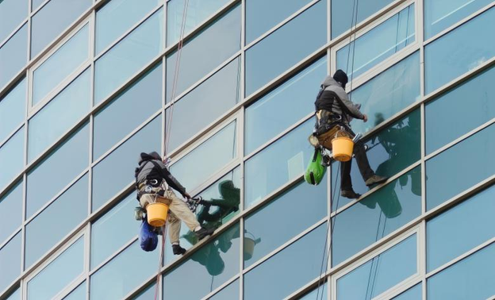
The Problem- Labor Cleaning Skyscrapers
The dangers of working at such heights
High skill requirement job leads to higher wages, hence more operational cost
Labor shortage due to high qualification and skill required
Limited working hours due to weather conditions

Slide 3

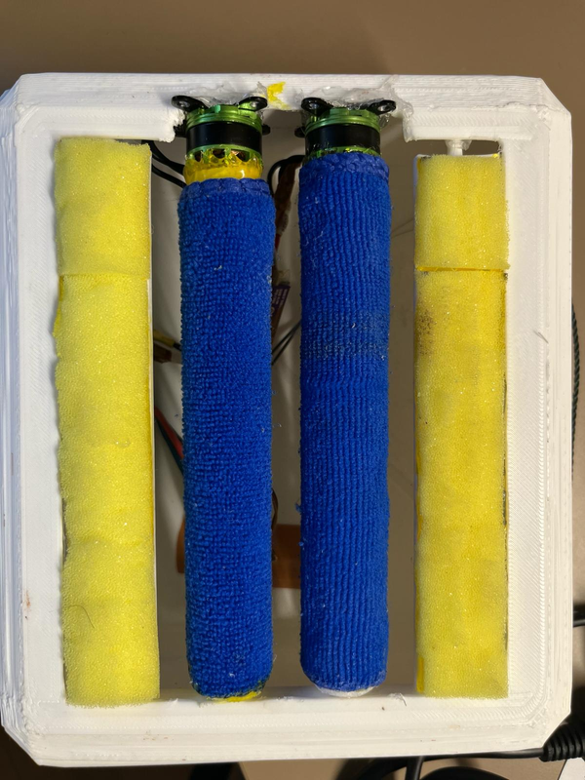


 | Autonomous Sky-Scraper Window Cleaning Robot
A | Coded with ESP-8266 WiFi Module inside Arduino IDE
Our Solution-Sky-Bot

Slide 4

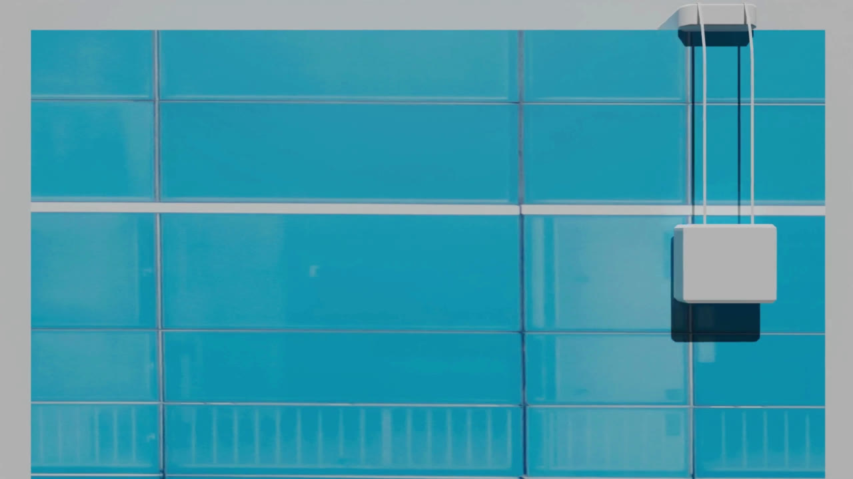
Functionalities
Climbs up and down using a servo motor connected through gears attached to a rope
Moves left and right using motors connected through a sliding mechanism on top
Uses the ultrasonic sensors to detect obstacles(end of glass panes) and change course of direction

Slide 5

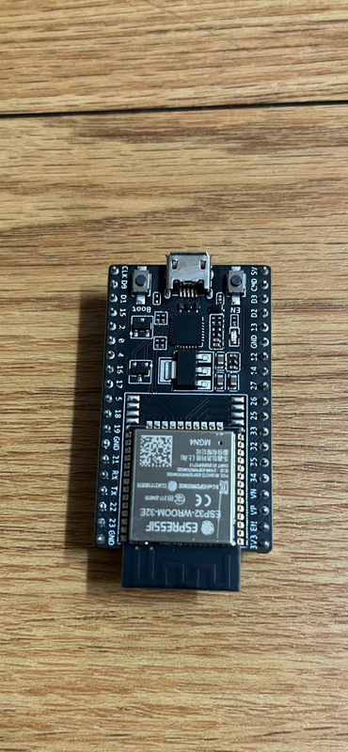
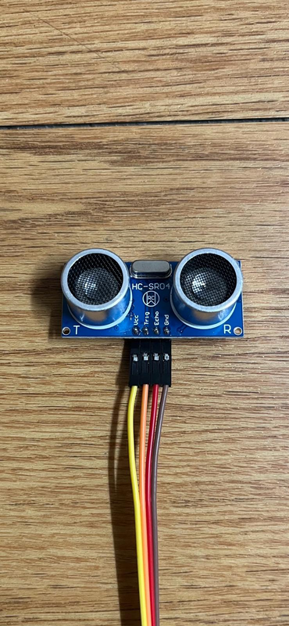
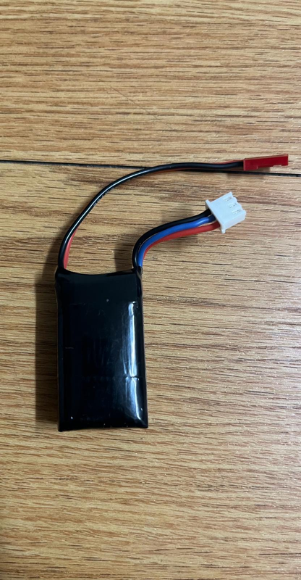
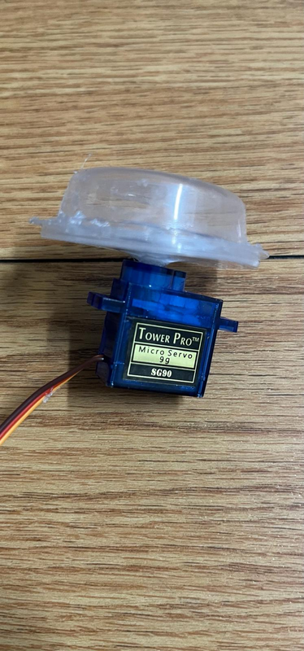

PARTS USED
ELECTRONICS
ESP- 8266
Ultrasonic Sensor
Battery
Servo Motor
FRAMEWORK
Main Cleaning Mechanism
3D Modelled Parts

Slide 6
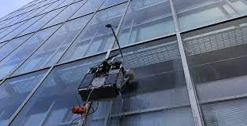
FUTURE ENVISION
The normal batteries can be replaced by Flint paper batteries
Upgrading the robots using suction system and make it functional for multi surfaces
Use OpenCV and ESP-CAM modules to enhance the cleaning experience
Integration of solar panel

Slide 7


 | BUSINESS MODEL
1
2
3
4
5
Value Proposition
Market Strategy
Target Audience
Revenue Potential
Scalability
Faster, Cleaner and Cheaper services
Lesser risk to human lives
Outreach Potential customers through email
Subscription based service, 1st servicing free
Building Managers in Singapore
Store owners abroad
Cleaning Companies
Commercial Real Estate owners and companies
Construction Companies
Government and Municipal buildings
Scaling into smaller models for household use
Expansion into other domains using robotics

Slide 8

Thank you!

